Slide 1

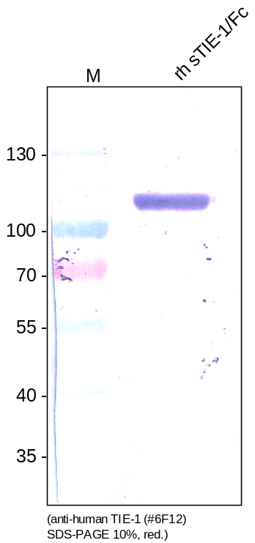
RELIATech GmbH
Mouse anti-human TIE-1 #6F12
(Cat #101-M48)
Figure 1: Western analysis of recombinant human soluble TIE-1/Fc chimera [Cat# SFC-012] using a mouse monoclonal anti-human TIE-1 #6F12 antibody [Cat# 101-M48].
http://www.reliatech.de / info@reliatech.de

